Slide 1
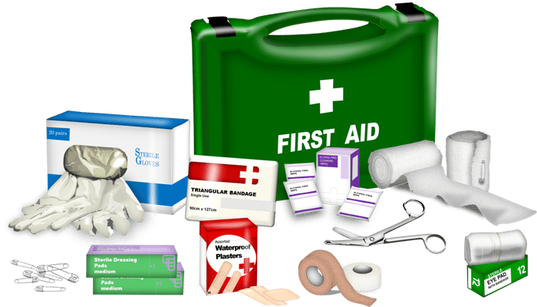
palliate
: verb
definition:
to relieve or lessen without curing

Slide 2
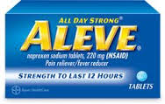
palliate
pronunciation:
pal-ee-eyt

Slide 3
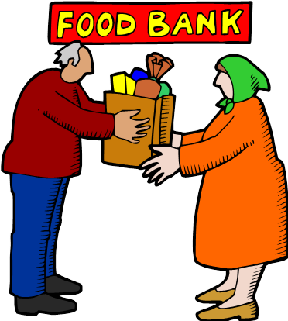
palliate
related forms:
noun
palliation (the act of)
palliator (person)
adjective
palliative

Slide 4
palliate
synonyms:
mitigate
alleviate
assuage
ease
temper
moderate
allay

Slide 5
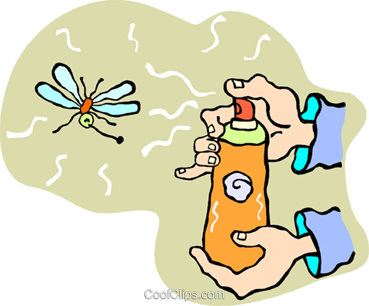
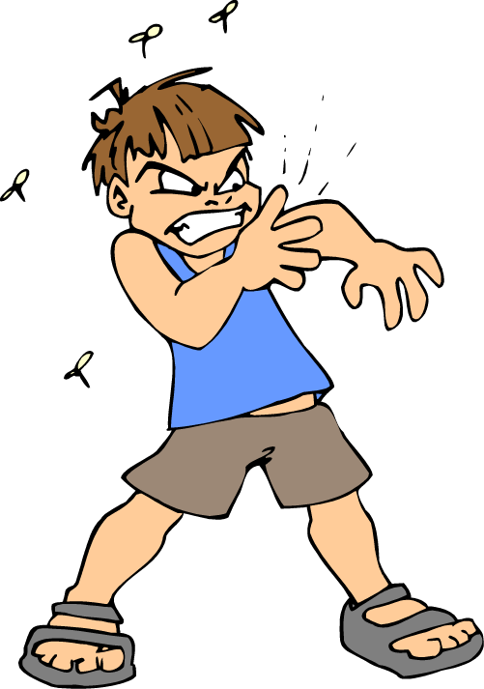
palliate
Using repellent before going outside palliates the annoying effect of insects.

Slide 6
palliate
Some products can palliate the symptoms of poison ivy, though they cannot eliminate the rash.

Slide 7
palliate
The politician needed to palliate the effect of his inappropriate remarks and blunders.

Slide 8
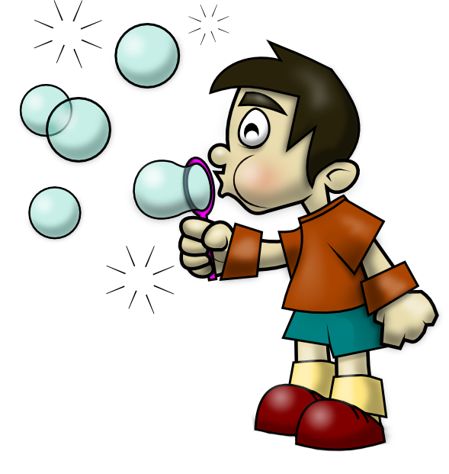
palliator
A palliator by nature, the young boy found pastimes that eased his stress.

Slide 9
palliation
A relaxing vacation can provide a sense of palliation.

Slide 10
palliative
Practicing yoga had a palliative effect on the woman.

Slide 11
palliative
Grilled cheese and tomato soup have a palliative effect, especially on a cold day.

