Slide 1
zeal: noun
definition: fervor for a person, cause, or object; eager desire or endeavor; enthusiastic diligence; ardor.

Slide 2
zeal
pronunciation:
zeal (noun)
zeel
zealot (noun)
zel- uh t
zealous (adj)
zel-uh s

Slide 3
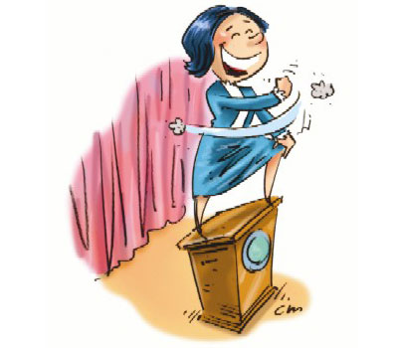
zeal
related forms:
zealous
zealously
zealot

Slide 4
zeal
synonyms:
enthusiasm
fanaticism
passion
fervor
ardor
keenness
eagerness

Slide 5
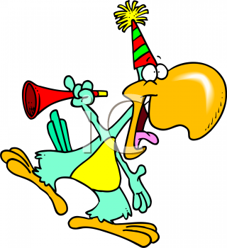
zeal
In his zeal for a good time, the toucan annoyed everyone at the party.

Slide 6
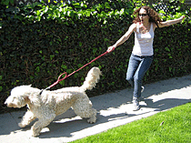
zeal
The dog’s zeal for running caught the woman off guard.

Slide 7
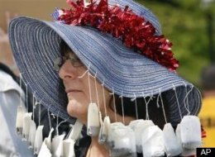
zeal
Tea lovers can carry their zeal for tea to ridiculous extremes.

Slide 8
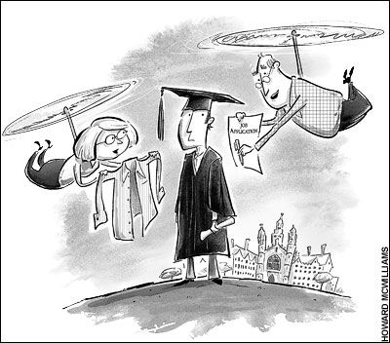
zealous
Over-zealous parents, criticized for doting on their children, are often referred to as helicopter parents.

Slide 9
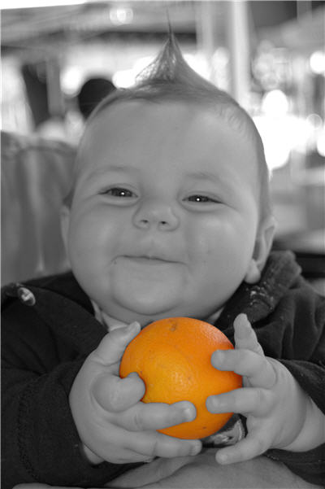
zealous
Even from a young age, some of us are zealous in our love for fruit.

Slide 10
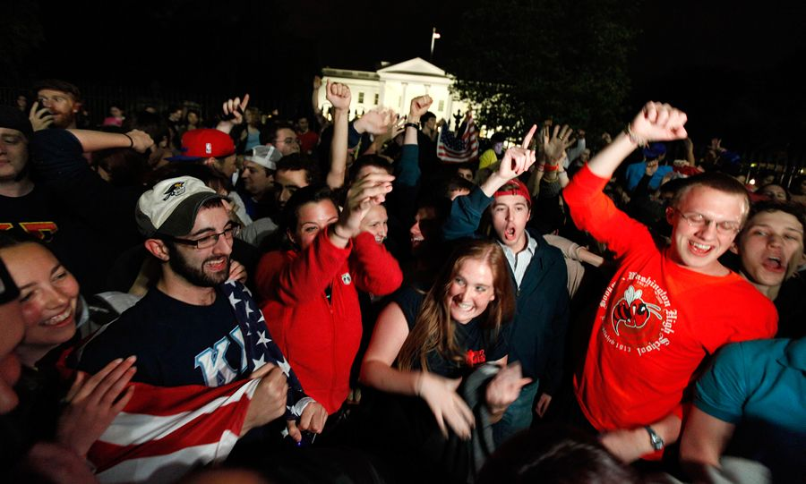
zealous
Americans were zealous as they celebrated Osama bin Laden’s death.

Slide 11
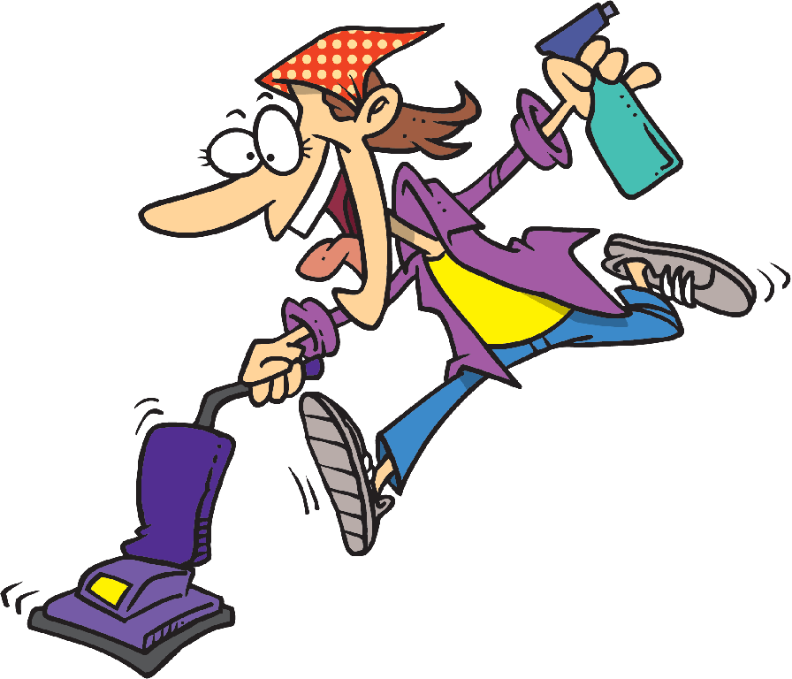
The eager housewife ran through her house , zealously striving to
keep the
house neat
and clean.
zealously

Slide 12
zealot
A zealot is the worst kind of salesman.

