Slide 1
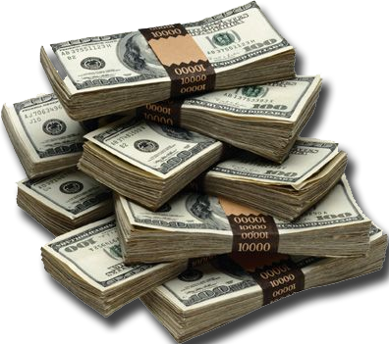
satiate: verb
definition:
to satisfy to the full

Slide 2
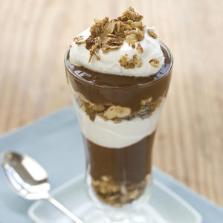
satiate
pronunciation:
sey-shee-eyt

Slide 3
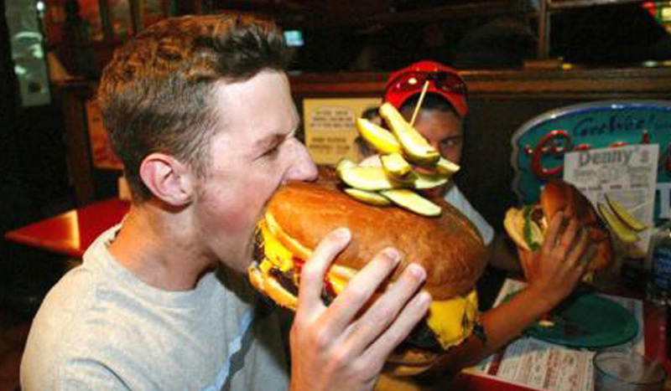
satiate
related forms:
noun
satiation
adjective
satiated
satiable
frequently used antonym: insatiable

Slide 4
satiate
synonyms:
quench
satisfy
sate
fill
saturate
gratify
surfeit
gorge

Slide 5
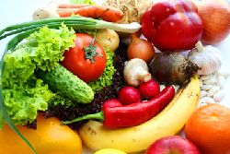
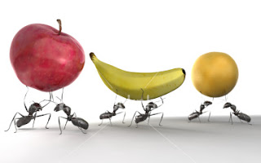
satiated
We weren’t satiated by the platter of fruits and vegetables, but
the ants were.

Slide 6
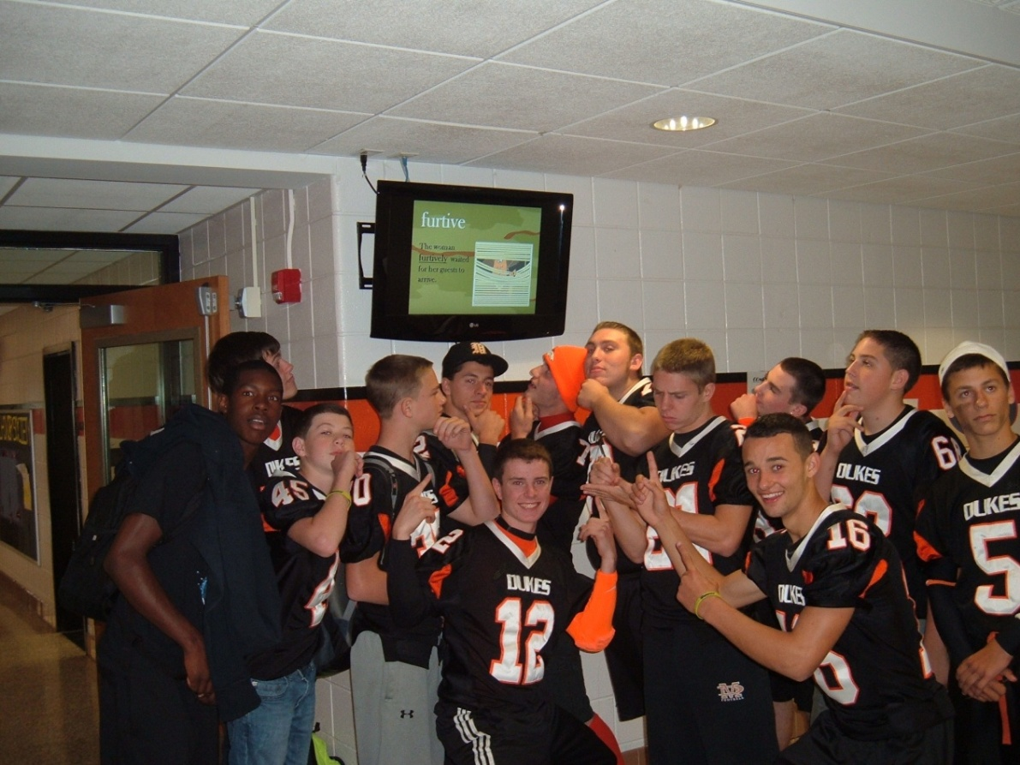
satiated
By the end of four years, Marlboro students
will be satiated with new vocabulary.

Slide 7
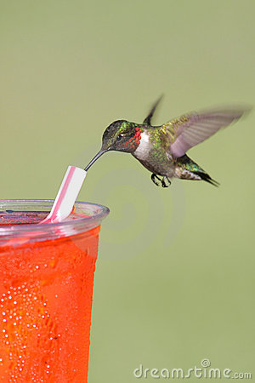
satiate
The hummingbird satiated his thirst by drinking juice through a straw.

Slide 8
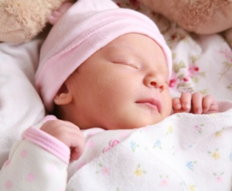
satiated
Satiated, the baby slept peacefully.

Slide 9
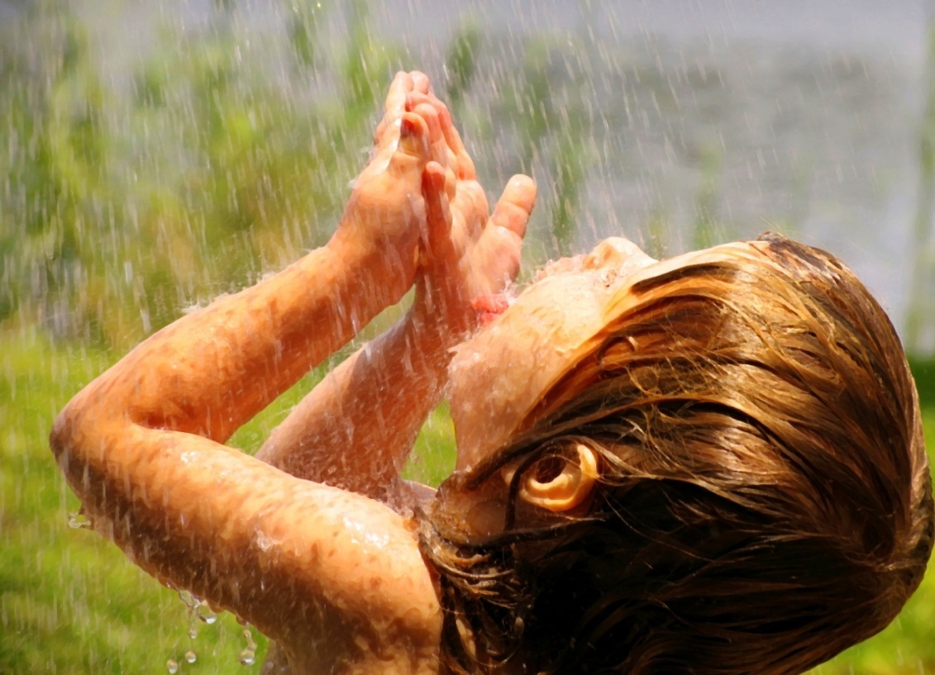
satiate
Parched, the young girl allowed the rain to satiate her.

Slide 10
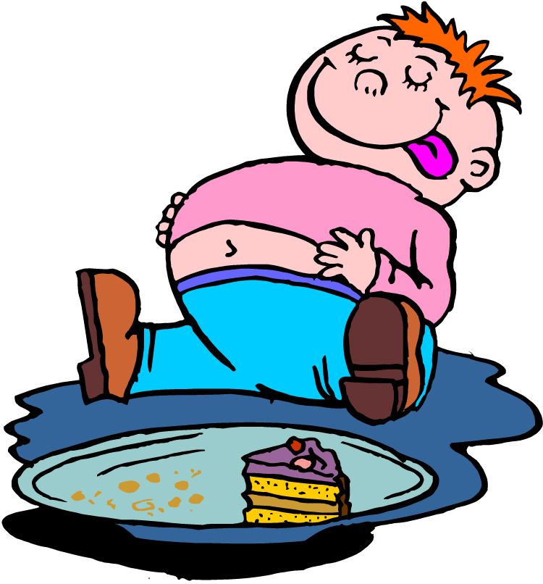
satiation
Satiation made the
young boy lazy.

Slide 11
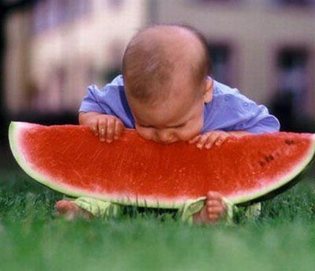
insatiable
The baby had an insatiable appetite.

