Slide 1
The Word of the
Week is . . .
wistful
This word is an adjective, used to describe people, places, or things.
Have you ever heard someone use this word to describe something?

Slide 2
wistful
wist-fuh l
Related Forms:
:wistfully, adverb
wistfulness, noun
unwistful, adjective
unwistfully, adverb
unwistfulness, noun
Definition:
*characterized by
melancholy
*longing, yearning

Slide 3
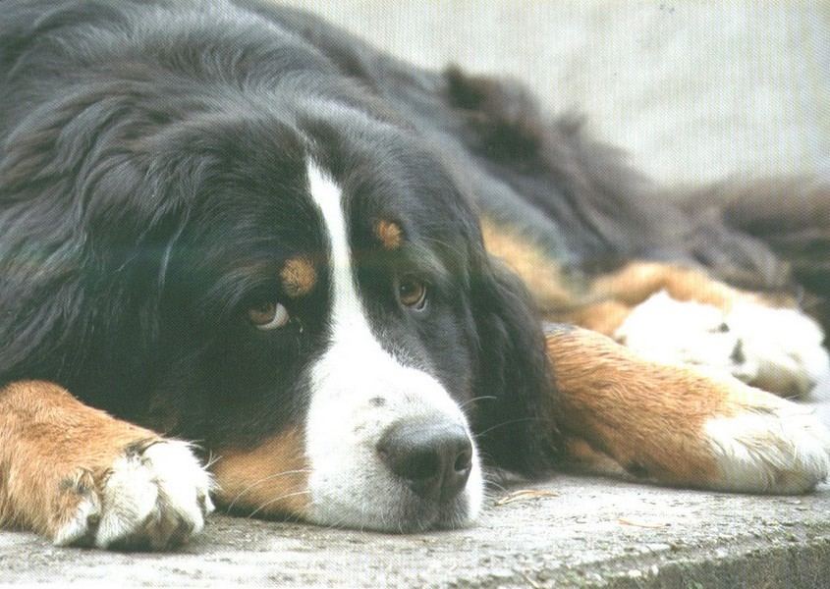
wistful
Synonyms:
*contemplative
*dreamy
*nostalgic
*thoughtful
*sad
*pensive

Slide 4
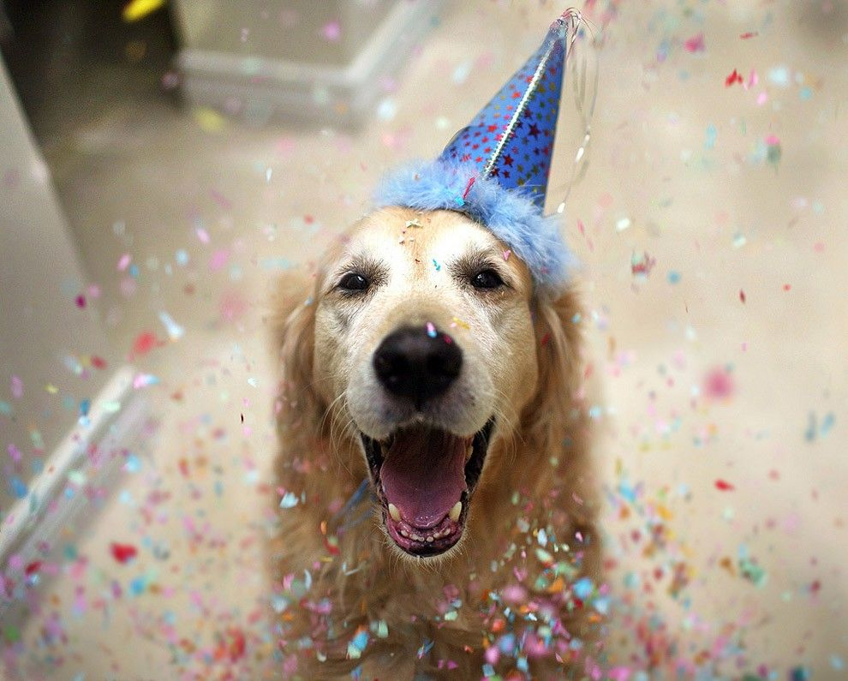
wistful
Antonyms:
*cheerful
*happy
*joyful
*negligent
*shallow
*uncaring

Slide 5
wistful
Even though her family was excited about their move to warm, sunny Florida, Sasha was feeling wistful about the friends that she was leaving behind.

Slide 6
wistful
Listening to certain music, like the blues, can put me in a wistful mood.
Is there a certain genre of music, or a specific song that makes you feel wistful? Share with a neighbor. (For me it is “My Way” by Elvis Presley)

Slide 7
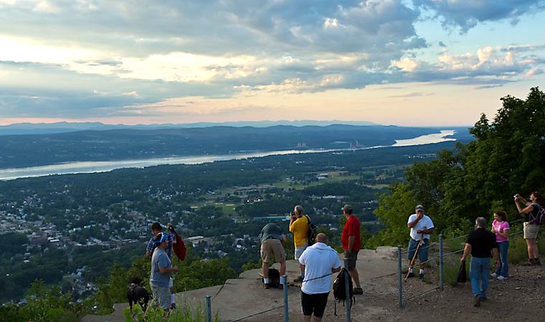
wistful
After a long hike up to the top of
Mount Beacon,
the man smiled wistfully as he
gazed out over
the beautiful
Hudson Valley below.

Slide 8
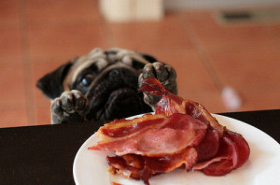
wistful
While the family was enjoying BLT’s for dinner, little Moses was wistful and hoped that someone might drop a morsel off their plate.

Slide 9
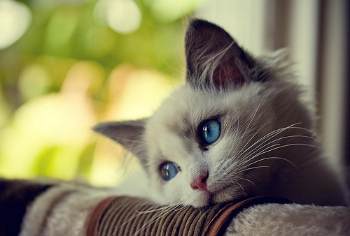
wistful
Turn & talk to a neighbor about a time when you were wistful and why. What were you longing for? A friend? A big change? Someone to listen to your feelings?

Slide 10
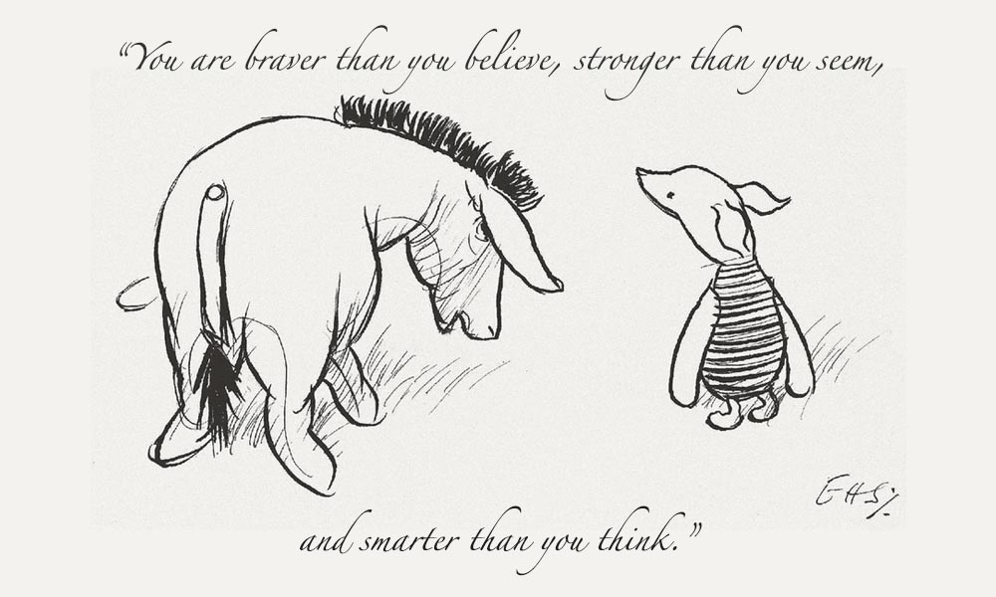
wistful
Writing Prompt:
Analyze the meaning of this quote. How can following these words make you a better version of yourself?

