Slide 1
The Word of the Week is:
winsome
Have you ever hear this word before?
Do you think you know its meaning?

Slide 2
winsome adjective
Definition:
*sweetly or innocently charming
*engaging

Slide 3
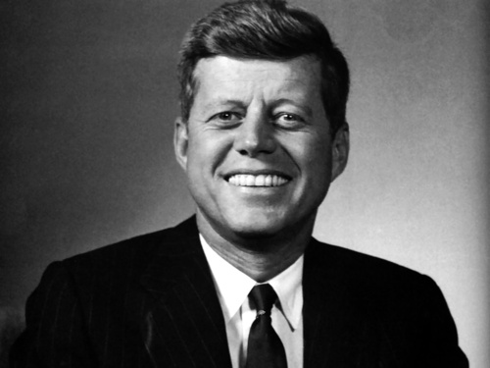
winsome
Synonyms:
*appealing *charismatic
*captivating *fascinating
*engaging *delightful

Slide 4
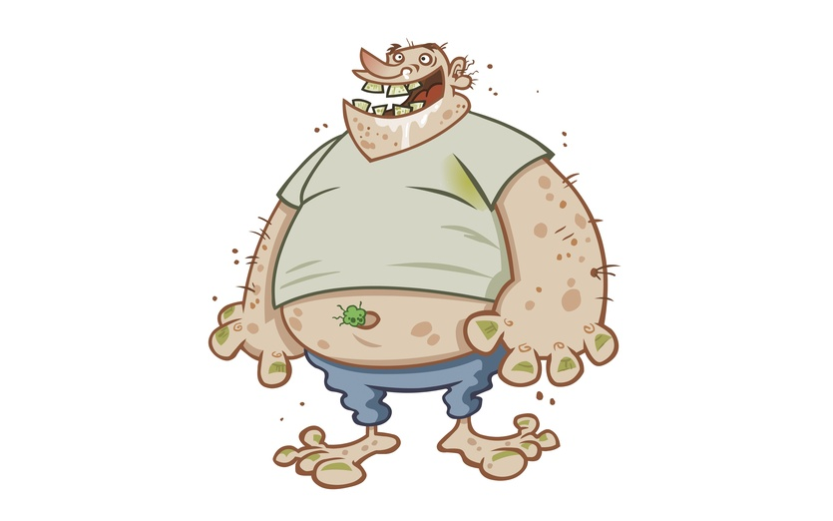
winsome
Antonyms:
*repulsive
*boring
*unpleasant *disagreeable

Slide 5
winsome
The Voice is a popular show because of the judges’ talent, criticism, and winsome personalities.

Slide 6
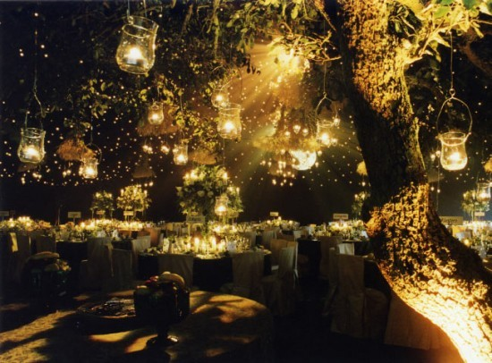
winsome
The bride and groom planned a winsome
wedding
for their guests.
What makes this wedding so magical & winsome?

Slide 7
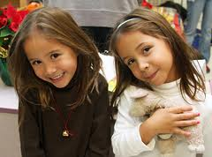
winsome
In school, their teachers describe the twins as winsome girls, who are polite, sweet, and supportive of each
other.

Slide 8
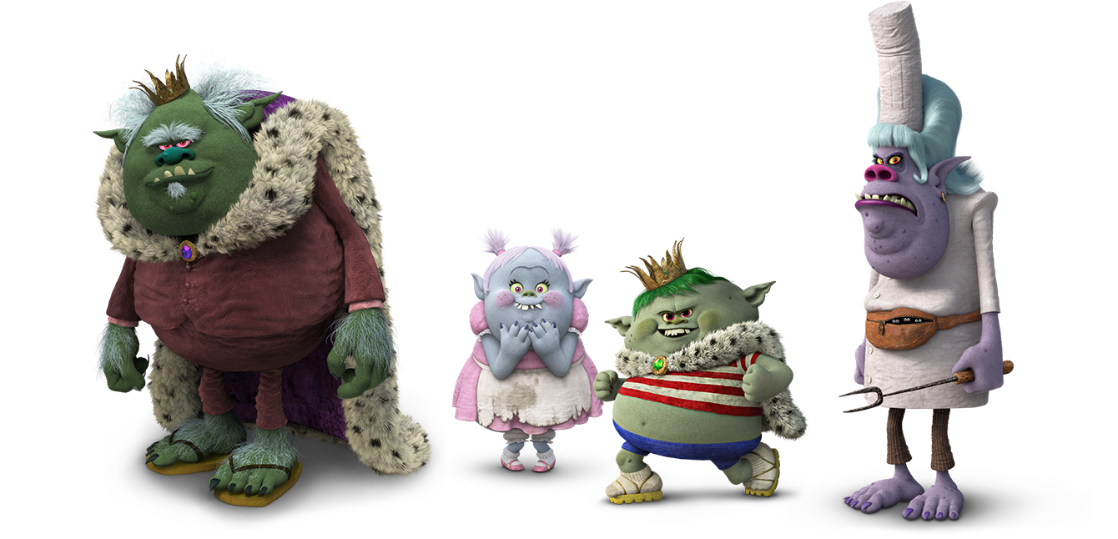
winsome
In the Trolls movie, the Bergens are not winsome, unlike the trolls who are very delightful.

Slide 9
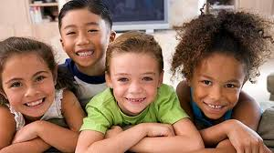
winsome
Why would you want to surround yourself with winsome people?

Slide 10
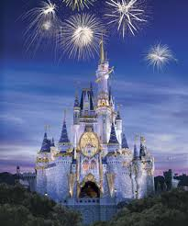
winsome
*Have you ever been to a winsome place?
*Do you know a winsome person?
*What qualities
do they have?

