Slide 1
The Word of the Week
strive
In order to strive, you have to be strong, be willing
to put forth effort, & determined to reach your goal.
What do you think strive means?

Slide 2
strive
verb
Definition:
to make a strenuous effort towards a goal
to try hard

Slide 3
strive
Synonyms:
to attempt
to go all out
to make every effort

Slide 4
strive
Antonyms:
to relax
to be unambitious
to be idle

Slide 5
strive
What are some ways that you can be the best version of YOU?
When starting each day, you should make a promise to strive to be the best version of yourself.

Slide 6
strive
Although she cooked well, she was
always striving to be
better by trying
new, harder
recipes from her
favorite chef.
Is there someone that you look up to and
strive to be like?

Slide 7
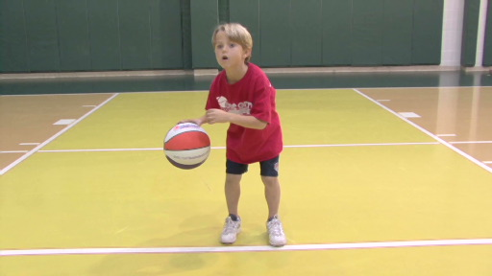
strive
As he tried basketball for the first time, he said to himself, “I will strive to learn how to dribble.”

Slide 8
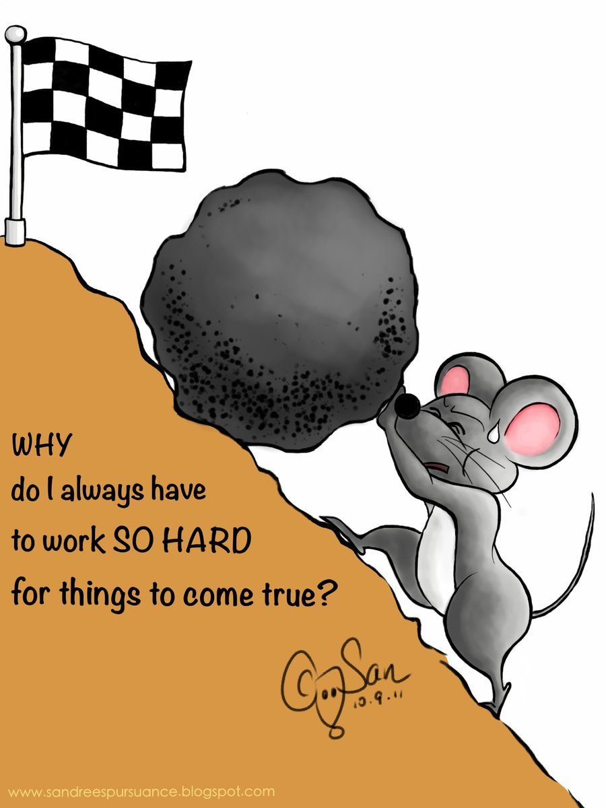
strive
Why must you strive in order for your dreams to come true?

Slide 9
strive
How does the following quote relate to the word, strive? How does it apply to your own life?

