Slide 1
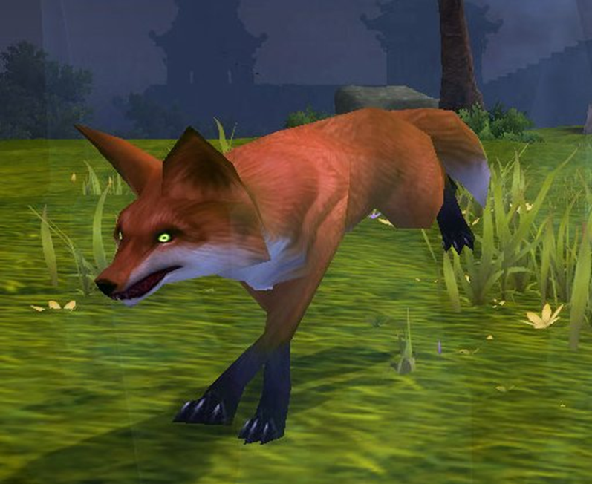
What do you think sly means?
Turn and talk to your friends.

Slide 2
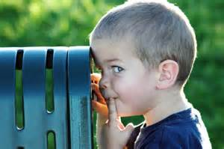
*Sly*
definition:
clever in a dishonest way
mischievous
sneaky

Slide 3
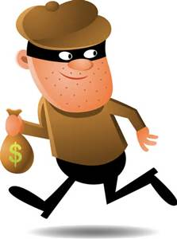
*Sly*
part of speech: adjective
pronunciation: ˈslī

Slide 4
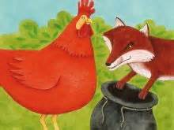
*Sly*
Synonyms:
crafty
naughty
tricky

Slide 5
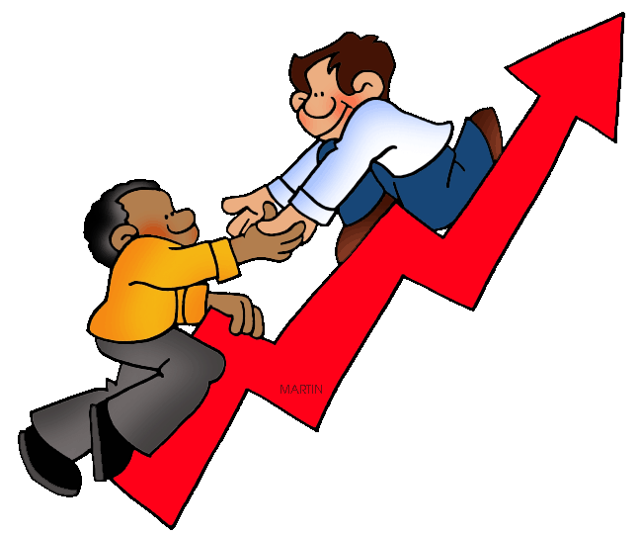
*Sly*
antonyms:
behaved
honest

Slide 6
*Sly*
The sly fox stole
the hen’s eggs.

Slide 7
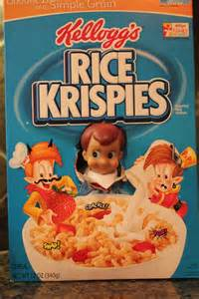
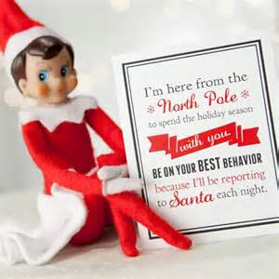
*Sly*
The sly elf hid many places in our house during Christmas.

Slide 8
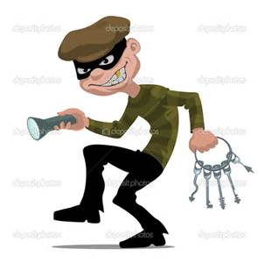
*Sly*
The thief was sly when he robbed the bank.

Slide 9
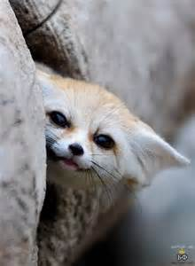
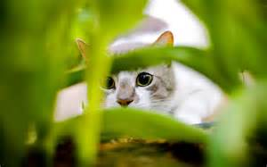
*Sly*
Did you see the sly animal hiding in the bushes?

Slide 10
Write a sentence with the word sly in it. Add as many details as you can.

