Slide 1
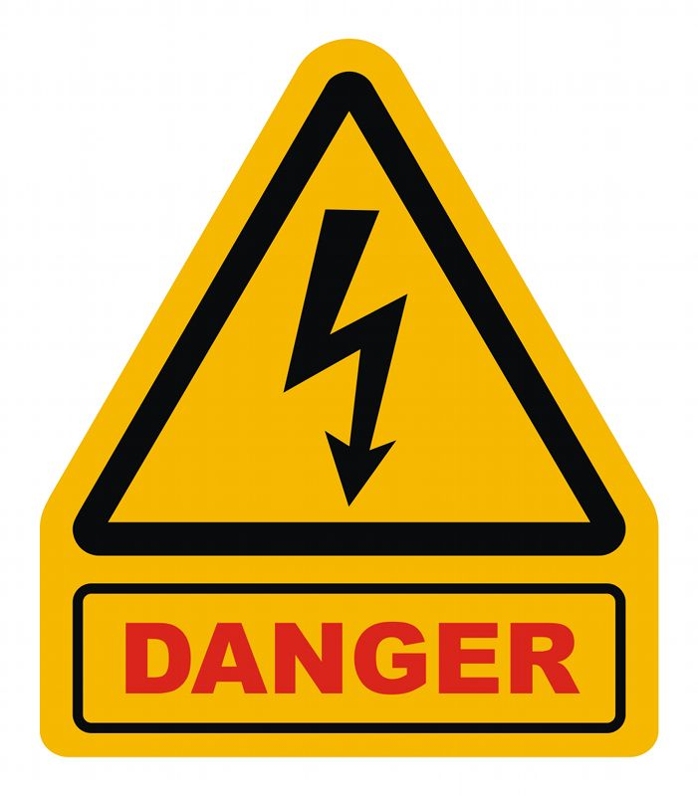
perilous:adj.
definition
involving or full
of great risk

Slide 2
perilous:adj.
definition
involving or full
of great risk

Slide 3
perilous:adj.
Pronunciation
per-uh-luhs

Slide 4
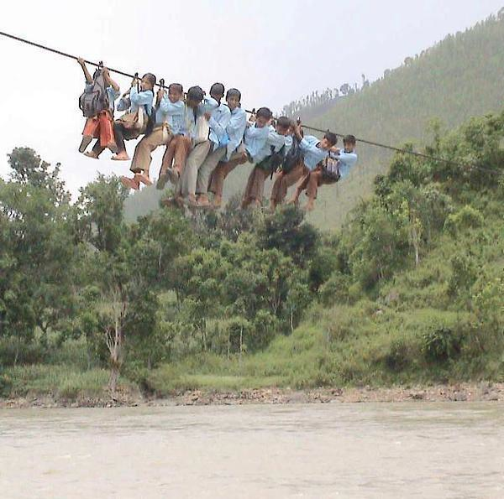
perilous:adj.
synonyms
dangerous
hazardous
risky

Slide 5
perilous:adj.
Cars must take this perilous curve slowly.

Slide 6
perilous:adj.
Smoking is
perilous to
your health.

Slide 7
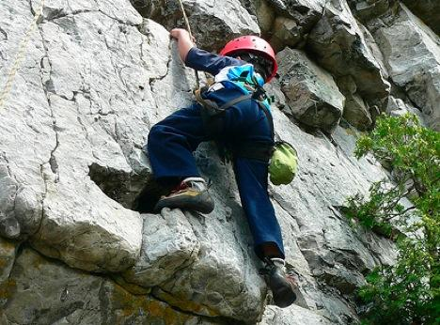
perilous:adj.
It is perilous for the little boy to climb this cliff.

Slide 8
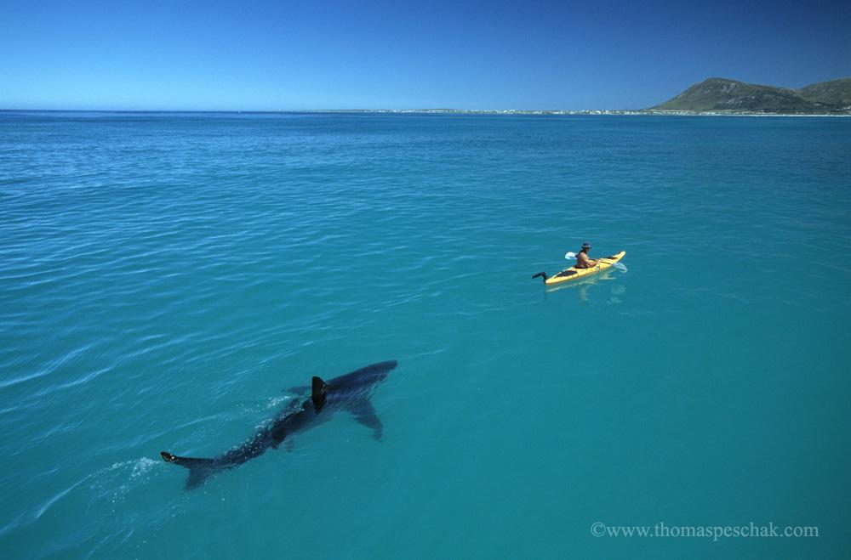
perilous:adj.
Why might this man be in a perilous situation?

Slide 9
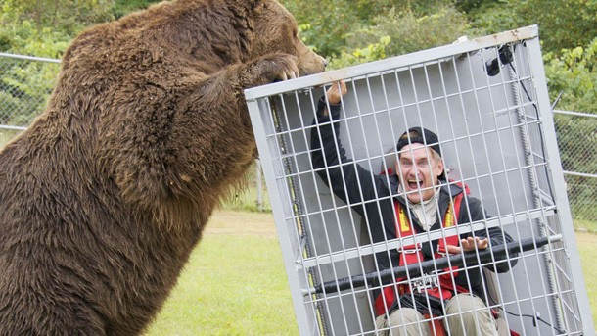
perilous:adj.
Have you ever been in a perilous situation? What was it?

