Slide 1
THe Word of the Week is . . .
infer
You have probably all heard this word before.
If you haven’t, find a buddy who has & ask them to share their knowledge of this word.
What does infer mean?

Slide 2
infer
in - fur
verb
Other forms of this word:
inferring (v)
inferred (v)
inference (n)
Definition:
*to derive by reasoning
*to conclude based on evidence

Slide 3
infer
Synonyms: Antonyms:
*assume *misunderstand
*figure out *disbelieve
*guess *neglect
*conclude *abstain

Slide 4
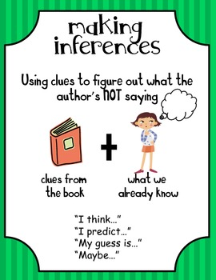
infer
Often times, authors do not “say” and “tell” their
meanings. Instead, they
leave behind clues for the readers to make inferences about the meaning of texts.

Slide 5
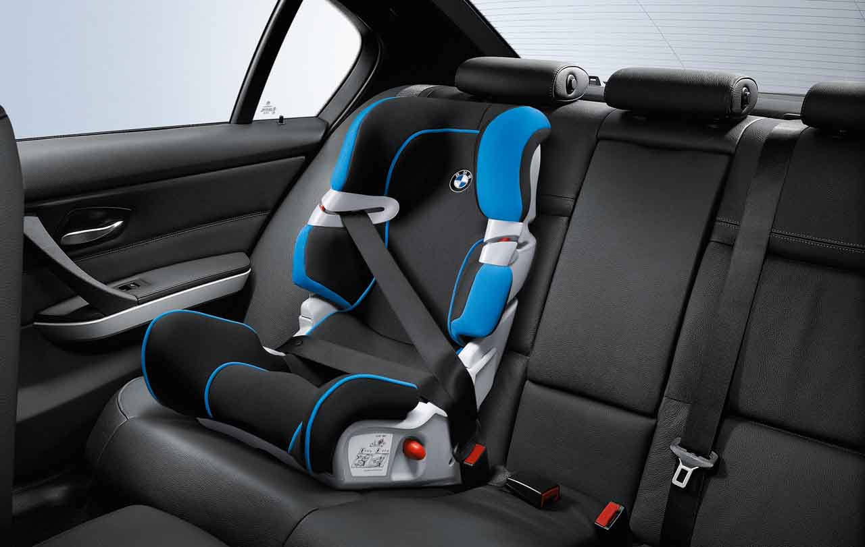
infer
What are some other clues you might find in a car where you would infer there is a
“baby on board?”
When you see a carseat in the back of
a car, you can infer
that the owners of the vehicle have a young child.

Slide 6
infer
Based on the lack of participation during the math lesson, the teacher inferred that the students needed more practice to master the concept.
What actions or body language do you think your teacher uses to infer how a lesson is going?

Slide 7
infer
Use your inferencing skills to come to a conclusion about what could be happening in this illustration.

Slide 8
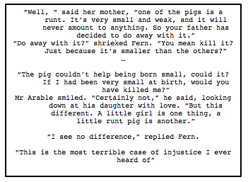
infer
Read the following excerpt.
What can you infer will happen in the future?

