Slide 1
Have you ever heard of the word humble? What do you think it means?
huhm buh l

Slide 2
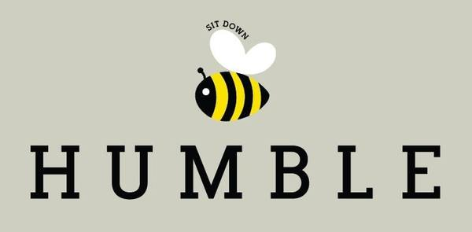
definition:
*avoids drawing attention to personal success or achievement

Slide 3
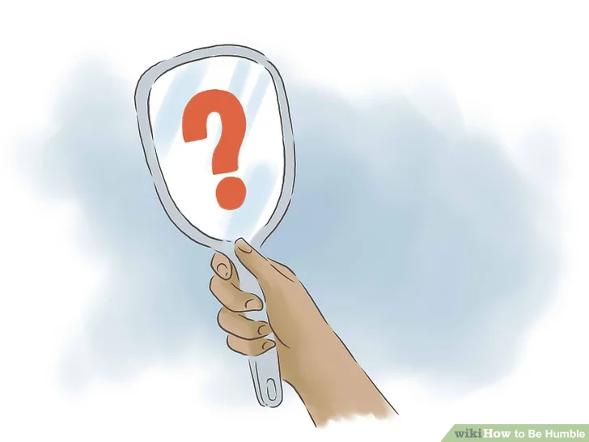
synonyms: *modest *respectful *unassuming
humble: adjective

Slide 4
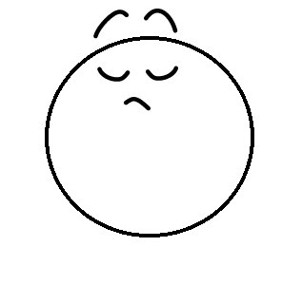
antonyms:
*arrogant *overly proud *rude

Slide 5
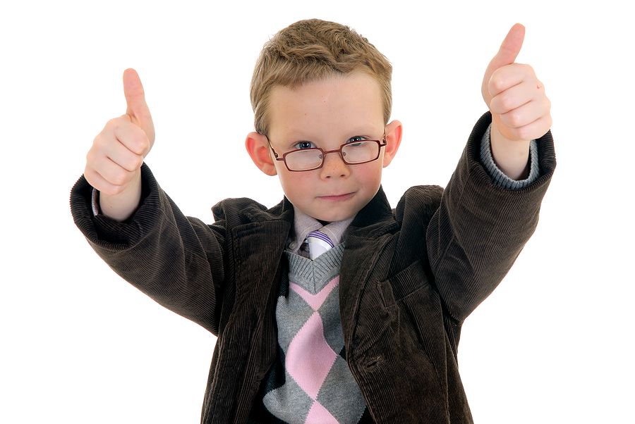
It is important to remain humble when we get compliments.

Slide 6
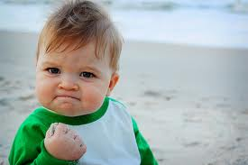
The child was not humble when he won the race.

Slide 7
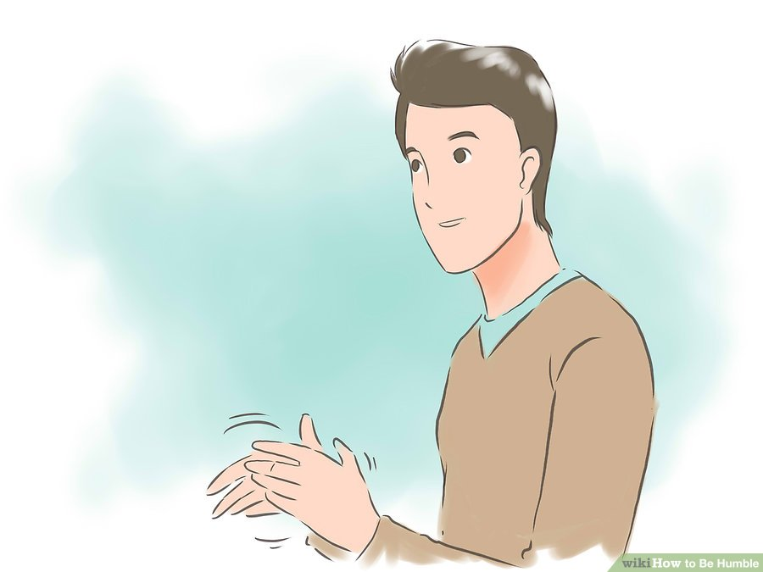
Being humble is appreciating others.

Slide 8
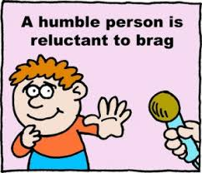
What do you think this quote means?

