Slide 1
hinder: verb
definition
to cause
difficulty in

Slide 2
hinder: verb
pronunciation
0
hin-der

Slide 3
hinder: verb
synonyms
interfere
hamper
hold back

Slide 4
hinder: verb
antonyms
allow
permit
promote

Slide 5
hinder: verb
Doing drugs
will hinder
your healthy
life-style.

Slide 6
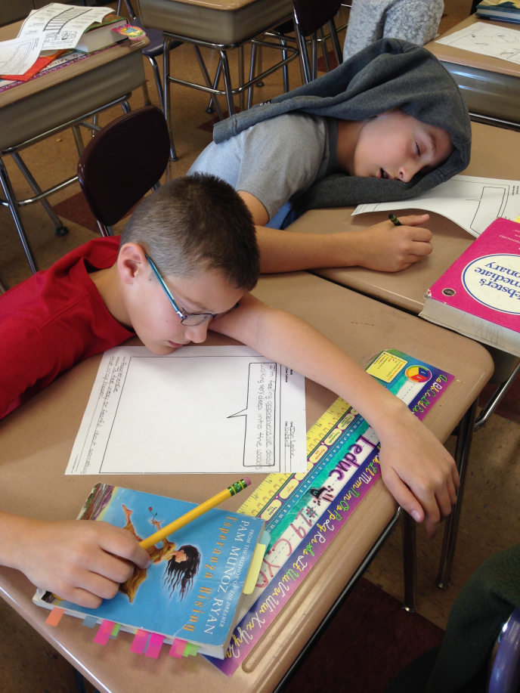
hinder: verb
Lack of sleep
may hinder
your ability
to do well on
the test.

Slide 7
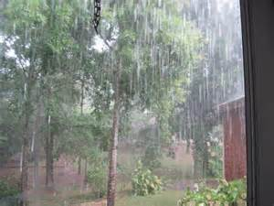
hinder: verb
The storm
hindered
our trip to
the farm.

Slide 8
hinder: verb
Being a bully
will hinder
your ability to
make friends.

Slide 9
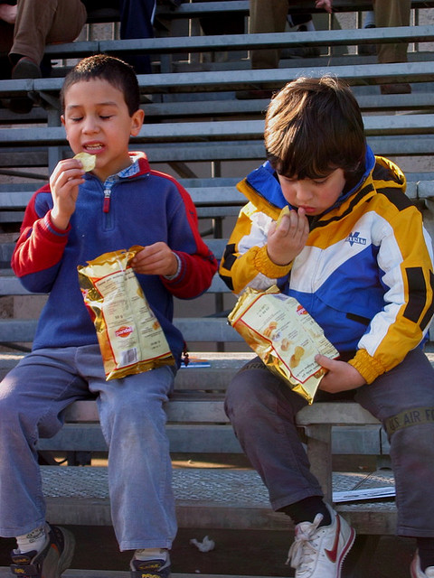
hinder: verb
What habits
hinder
your health?

Slide 10
hinder: verb
What can you do
to ensure that
your health is
not hindered?

