Slide 1
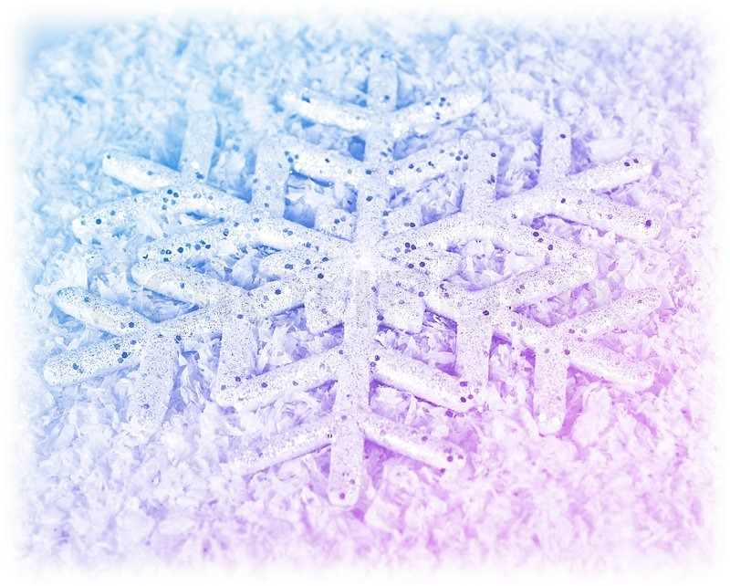
What do you think the word gigantic means?
Turn and talk to a friend next to you.

Slide 2
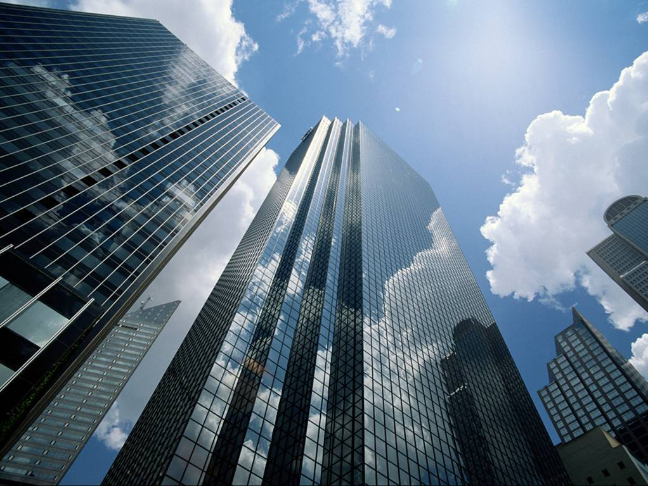
gigantic
adjective
definition:
Very large; huge

Slide 3
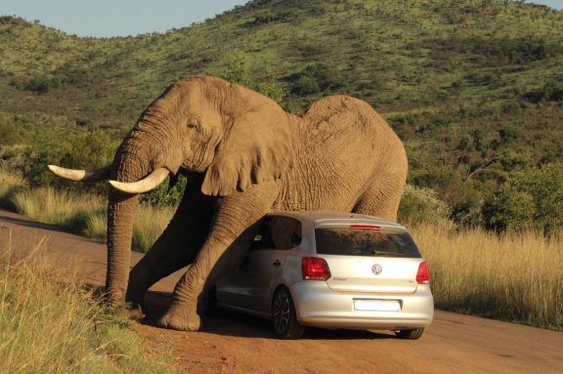
gigantic
synonyms:
enormous
huge
giant
Massive
colossal

Slide 4
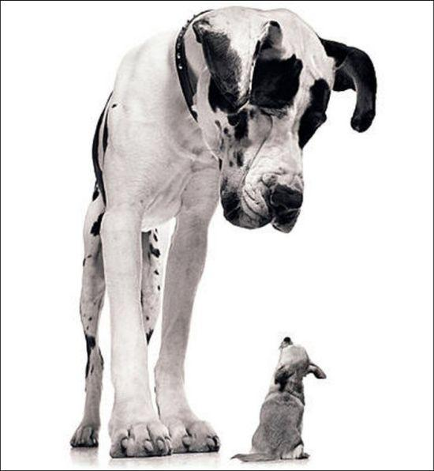
What is the opposite of gigantic? What are some antonyms?

Slide 5
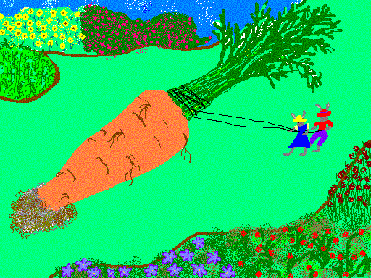
gigantic
Mr. and Mrs. Rabbit had a hard time pulling the gigantic carrot from the ground.

Slide 6
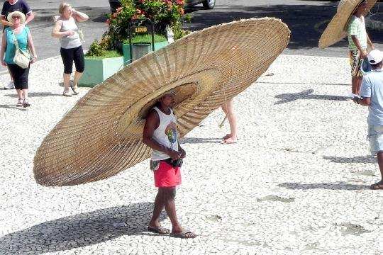
gigantic
The gigantic hat blocked the sun from the man’s face.

Slide 7
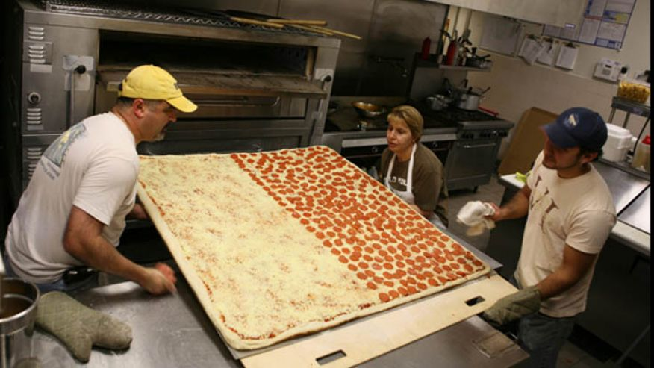
gigantic
The pizza was so gigantic that it took 3 people to put it in the oven.

Slide 8
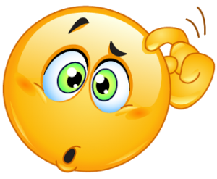
gigantic
What things are gigantic?

Slide 9
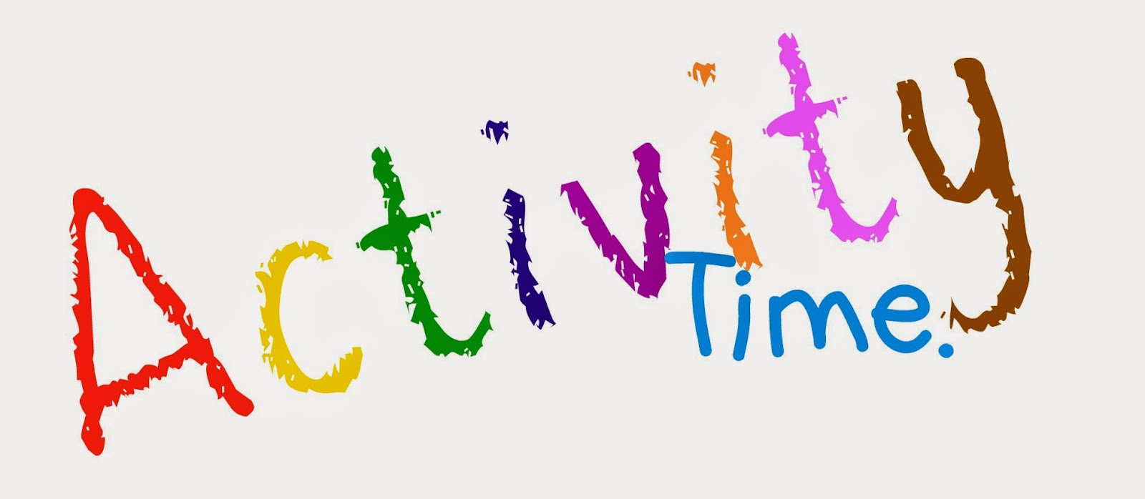
Fold a piece of paper in half.
On the left side of the paper draw a picture of something gigantic.
On the right side, draw an antonym of gigantic.
Label and/or write about each picture.

