Slide 1
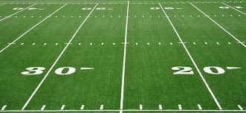
What do you think the word fumble means?
Turn and talk to someone next to you.

Slide 2
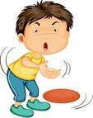
fumble verb
definition:
to handle clumsily; to do something awkwardly

Slide 3
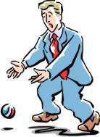
fumble verb
synonyms:
*mishandle
*stumble
*mess up

Slide 4
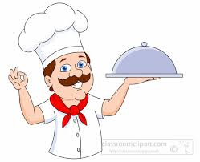
fumble verb
antonyms:
*succeed
*do well

Slide 5
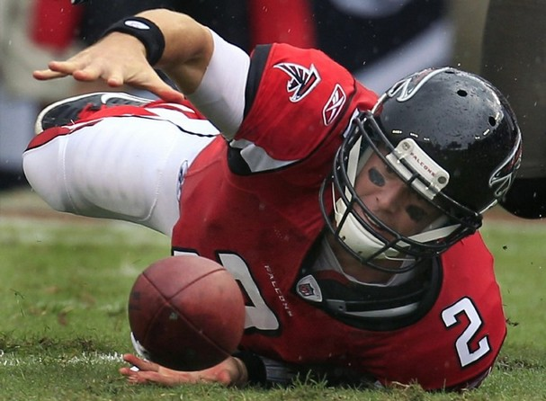
fumble verb
The football player tried hard not to fumble the ball.

Slide 6
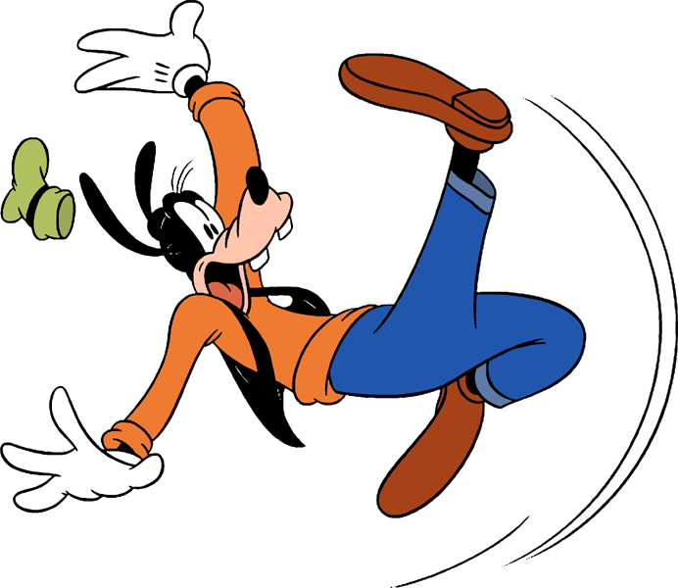
fumble verb
Goofy fumbled on his way out of the door.

Slide 7
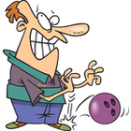
fumble verb
The man fumbled the bowling ball, dropping it on his foot.

Slide 8
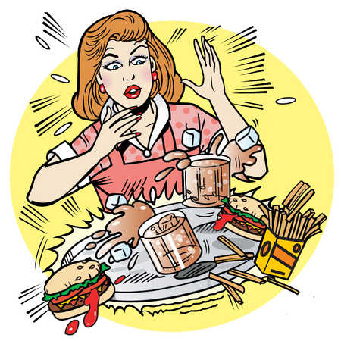
fumble verb
What happened
when the waitress
fumbled the
tray?

