Slide 1
The Word of the Week is . . .
delectable
Have you ever heard this word before?
Do you think you know what it means?
Turn & talk to a neighbor about your knowledge of delectable.

Slide 2
delectable
[dih-lek-tuh-buh l]
adjective - used to describe a noun
Definition:
delightful; highly pleasing
enjoyable

Slide 3
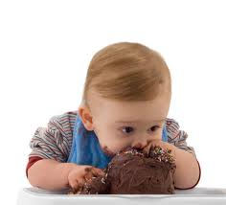
delectable
Synonyms:
*appetizing *exquisite
*delightful *satisfying
*heavenly *yummy

Slide 4
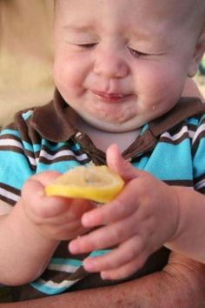
delectable
Antonyms:
*tasteless
*unappetizing
*distasteful
*unpleasant

Slide 5
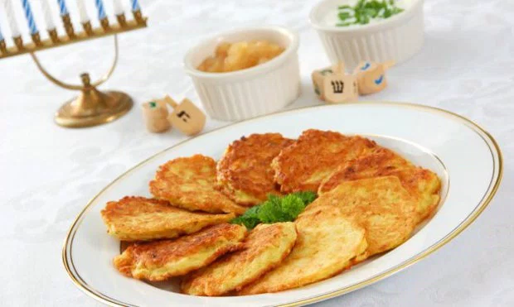
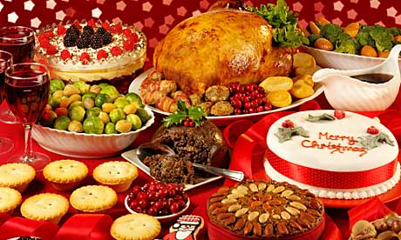
delectable
During the holiday season there are many delectable treats to choose from. Be sure to balance them with healthy choices!

Slide 6
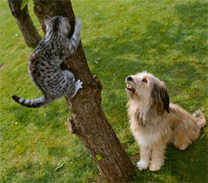
delectable
The dog thought the cat looked like a delectable pal, but could never get close enough to play with her.

Slide 7
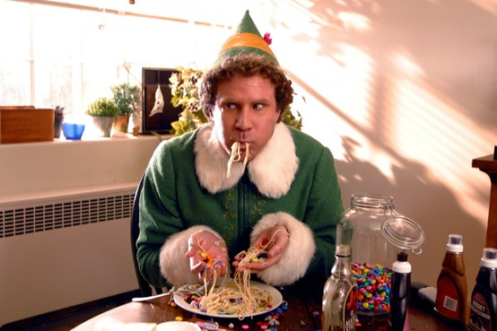
delectable
Although most do not, Buddy the Elf, finds chocolate, candy, and maple syrup to be delectable on pasta.

Slide 8
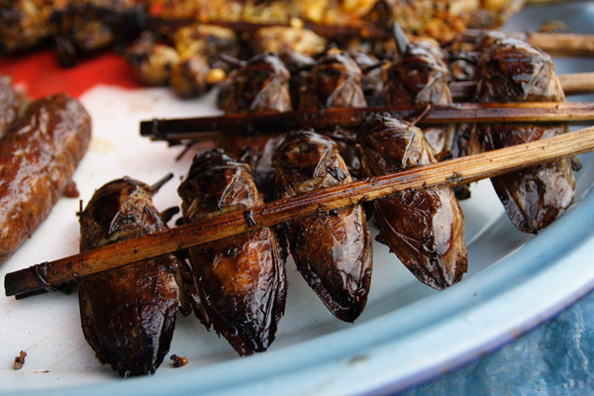
delectable
Some cultures find bugs to be a delicacy. What sort of things do you find delectable that others may not?

Slide 9
delectable
Make a list of your favorite delectable foods. Choose one to illustrate. Add detail & a caption that will entice your audience to want to try it.

