Slide 1
The Word of the Week is . . . callous
Have you ever read or heard
this word before?
*Turn and talk to a neighbor and discuss your understanding of the word callous.

Slide 2
callous
kal - uhs
adjective
If you do a lot of work with your hands, you develop a callous, which is a noun of this adjective.
Definition:
*Made hard; hardened

Slide 3
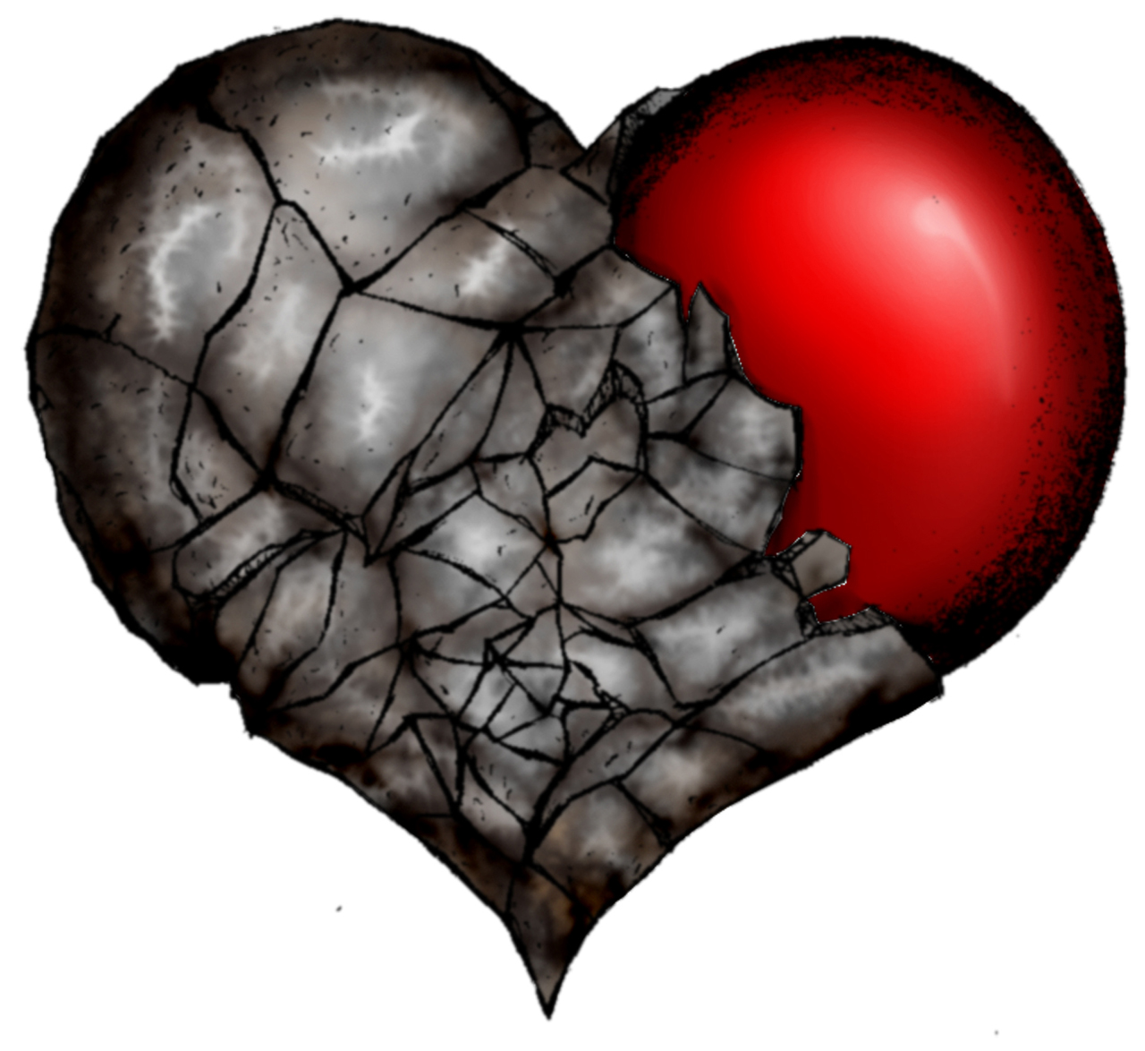
callous
Synonyms
*careless
*cold-blooded
*insensitive
*uncaring

Slide 4
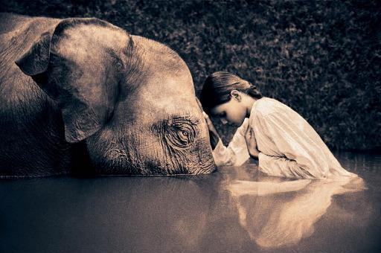
callous
Antonyms
*caring
*compassionate
*concerned
*sympathetic

Slide 5
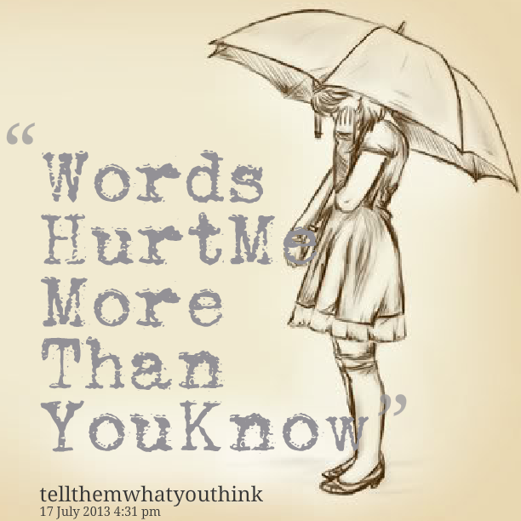
callous
The boy’s callous words were hurtful to his classmates and often left him lonely on the playground.
Why do you think the boy was alone on the playground?

Slide 6
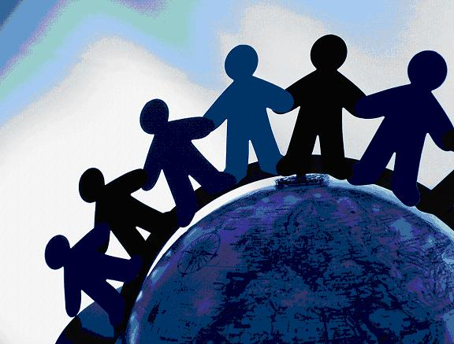
callous
Many people treat the Earth with callousness, but we must be sure to take care of our planet for, not only for ourselves, but for future generations.
What do you do to prove your love for Mother Earth?

Slide 7
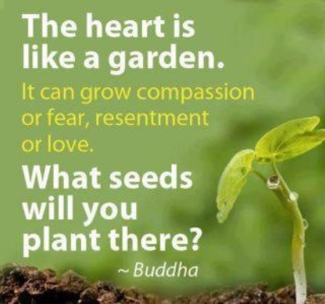
callous
It is very easy to become callous and desensitized in our wild, busy,
tech-crazy world.
However, it is important to reach out to your fellow friends. Read the following quote and write about the kinds of seeds that are “growing” in your “garden”

