Slide 1
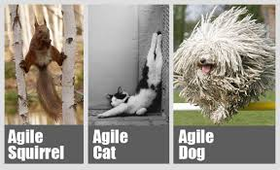
What do you think agile means?
Turn and talk to your friends.

Slide 2
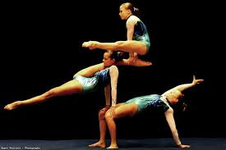
agile
definition:
*able to move quickly and easily
*able to think quickly, solve problems, and have new ideas

Slide 3
agile
part of speech: adjective
pronunciation: (ăj′əl, -īl′)

Slide 4
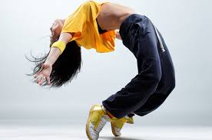
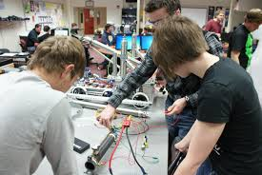
agile
Synonyms:
fast
quick
swift
intelligent
wise

Slide 5
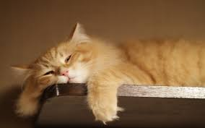
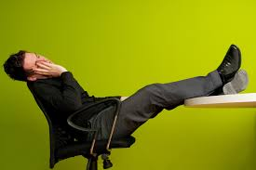
agile
agile
Antonyms:
slow
inactive
dull

Slide 6
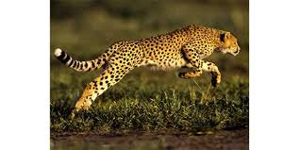
agile
agile
The cheetah is an agile hunter.

Slide 7
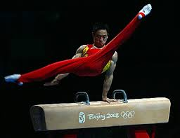
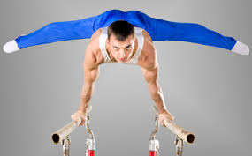
agile
The agile gymnast showed his talents on the balance beam and bars.

Slide 8
agile
Luckily, the man was agile or else he would have been late for his meeting.

Slide 9
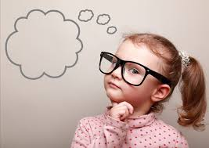
agile
The clever, agile
girl could easily do hard math problems in her head.

Slide 10
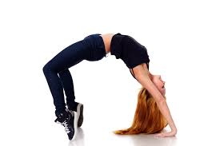
agile
Are you an agile student?

Slide 11
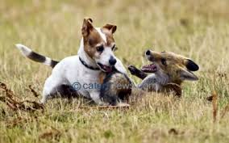
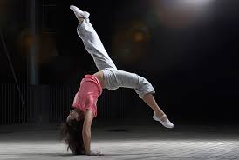
agile
Can you think of a sentence with agile?

