Slide 1
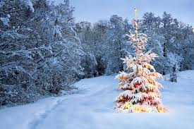
GOODWILL
Definition: a kind,
helpful, or friendly
feeling or attitude

Slide 2
GOODWILL
Pronunciation:
good·will
Noun

Slide 3
GOODWILL
Synonyms:
Friendliness
Kindness
Fellowship

Slide 4
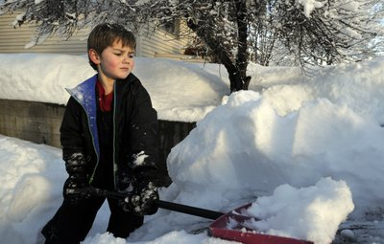
GOODWILL
He showed goodwill
by shoveling his neighbor’s driveway.

Slide 5
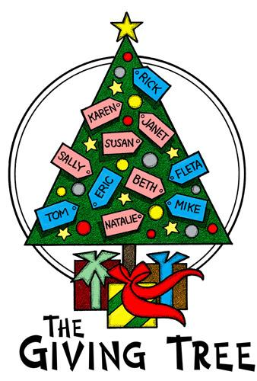
GOODWILL
She demonstrates
goodwill by donating
to the Giving Tree every year.

Slide 6
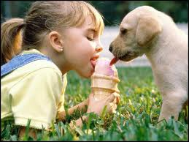
GOODWILL
When you share
with someone,
you show goodwill.

Slide 7
GOODWILL
If everyone practiced
goodwill, everyone would
be good to one another.

Slide 8
GOODWILL
Have you
experienced
goodwill recently?

Slide 9
GOODWILL
How will you show
goodwill this holiday season?

