Slide 1
Our Word of the Week is… gist
What do you think this word means?

Slide 2
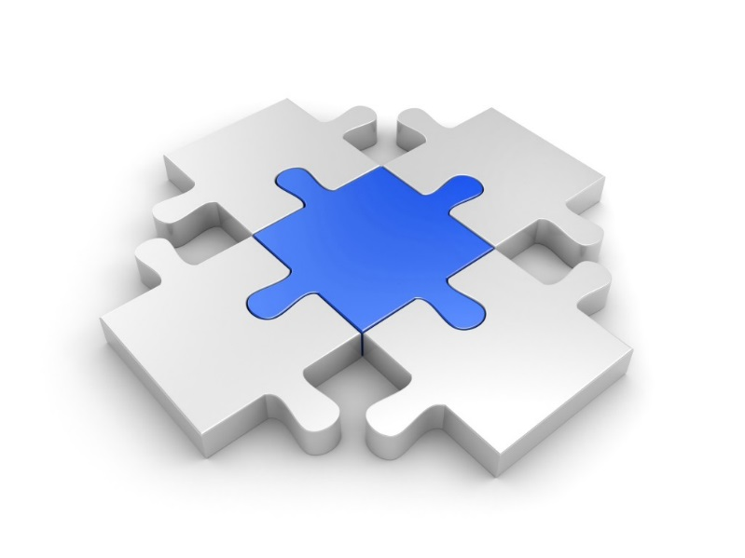
gist jist noun
Definition:
*the main part of something

Slide 3
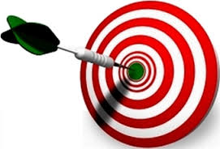
gist
Synonyms
*point
*idea
*bottom line

Slide 4
gist
Antonyms
*meaninglessness
*insignificance

Slide 5
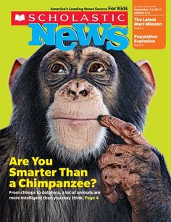
gist
After reading
an article in our Scholastic News, we wrote the gist.

Slide 6
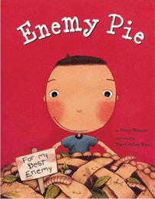
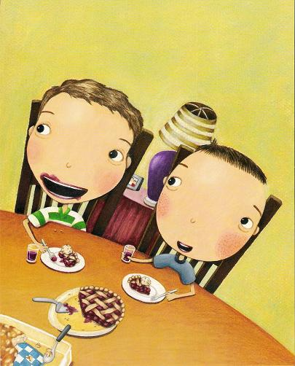
gist
The gist, or lesson, of Enemy Pie, is not to judge a person before you get to know them.

Slide 7
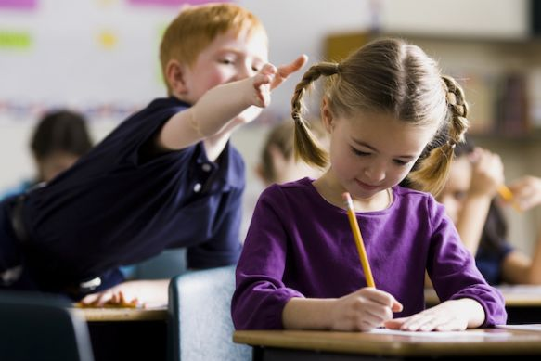
gist
Because they were not paying attention, the children missed the gist of the math lesson.

Slide 8
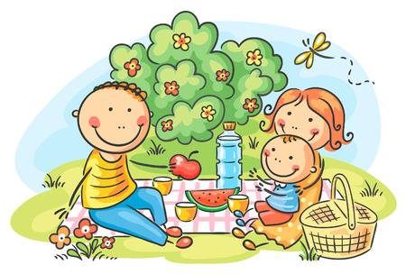
What is the gist of the picture below?

Slide 9
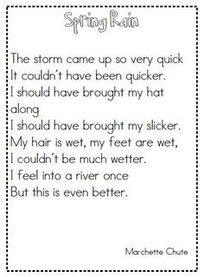
What is the gist of the poem?

