Slide 1
Word of the Week
Commiserate

Slide 2
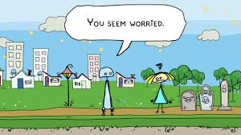
com·mis·er·ate
kəˈmizəˌrāt/
verb
Latin origin

Slide 4
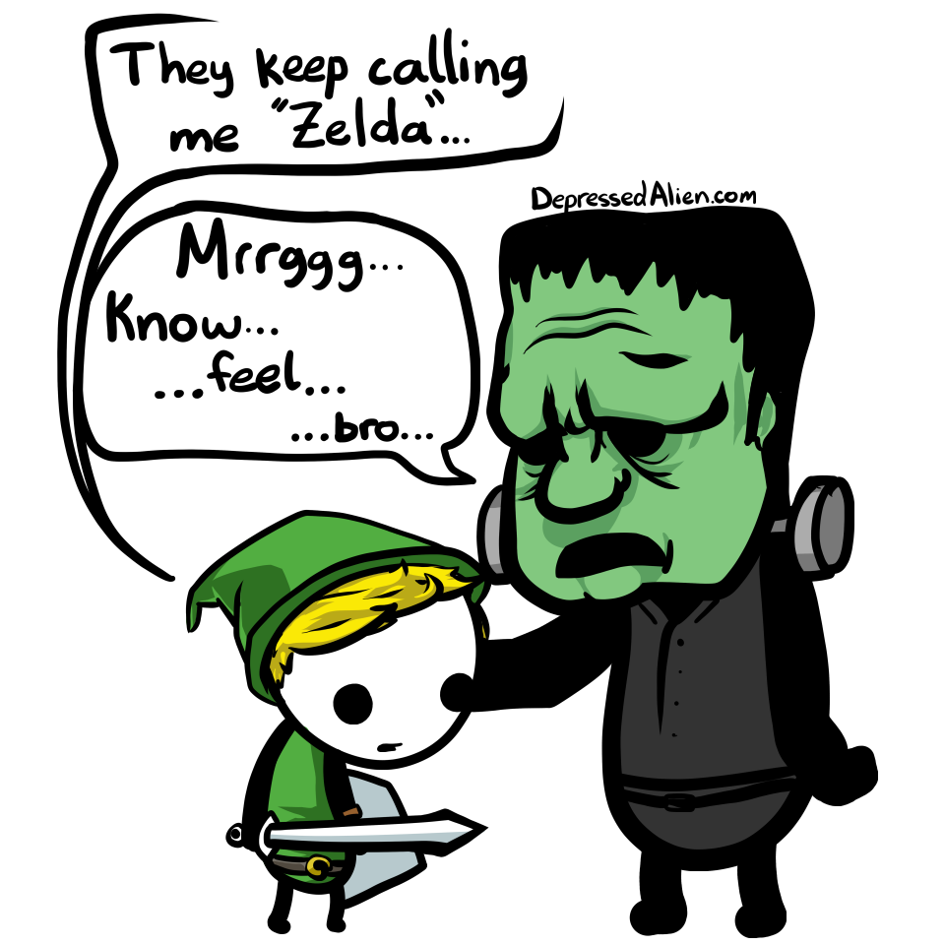
Synonyms Antonyms
sympathize be indifferent
console disregard
pity turn away
feel for
worry

Slide 5
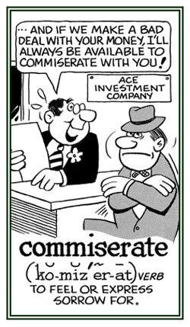
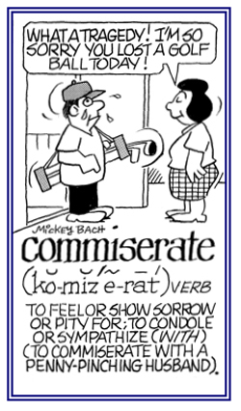

Slide 6
Today, we commiserate with those who have lost loved ones in the war.

Slide 7
