Slide 1
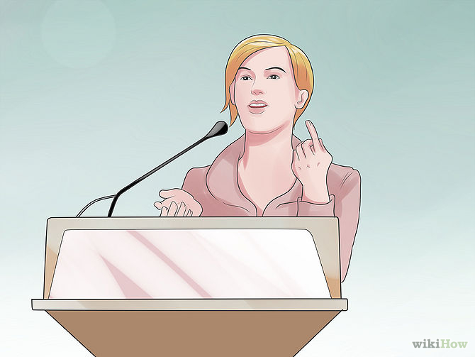
Articulate
Verb or Adjective
Definition: V. express (an idea or feeling) fluently and coherently
Adj. (of a person or a person's words) having or showing the ability to speak fluently and coherently

Slide 2
articulate
Pronunciations:
Verb- ärˈtikyəˌlāt (AR-Tick-Yuh-Late)
Adjective- ärˈtikyələt (AR-Tick-Yuh-Lit)

Slide 3
articulate
Synonyms:
Verb- express, vocalize, communicate
Adjective- eloquent, persuasive, fluent

Slide 4
articulate
Antonyms:
Inarticulate
Unclear
Unintelligible

Slide 5
quotes
“Why is it so hard to articulate love yet so easy to express disappointment?” ― Kaui Hart Hemmings, The Descendants
“Some concepts are so incredibly risky they take an honest fool to try to articulate them.” ― Criss Jami, Killosophy

Slide 6
