Slide 1
IDIOSYNCRATIC

Slide 2
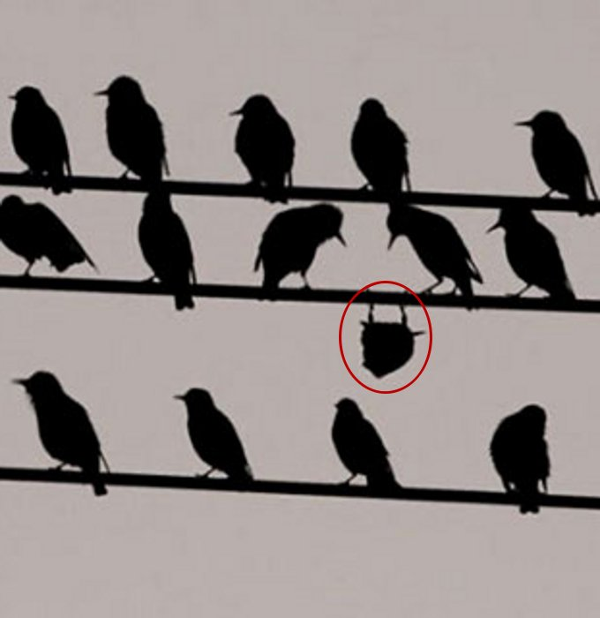
IDIOSYNCRATIC - PRONUNCIATION
ˌI-DĒ-Ō-(ˌ)SIN-ˈKRA-TIK

Slide 3
IDIOSYNCRATIC - DEFINITION
OF OR RELATING TO IDIOSYNCRASY; PECULIAR TO THE INDIVIDUAL
IDIOSYNCRASY = AN UNUSUAL WAY OF BEHAVING OR THINKING THAT IS CHARACTERISTIC OF A PERSON

Slide 4
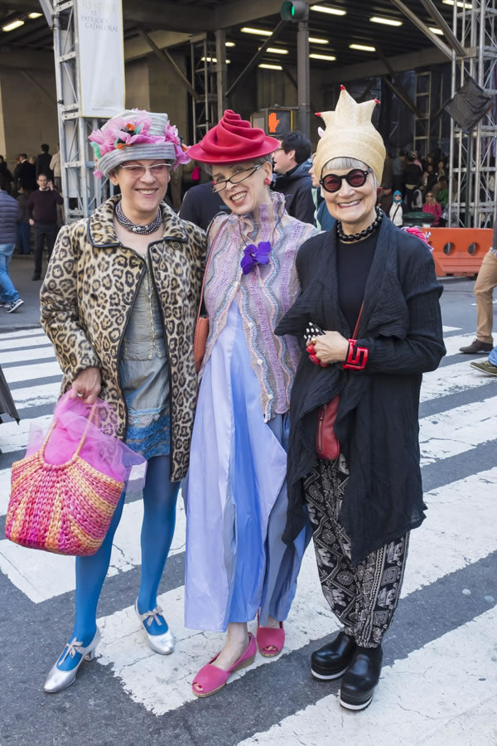
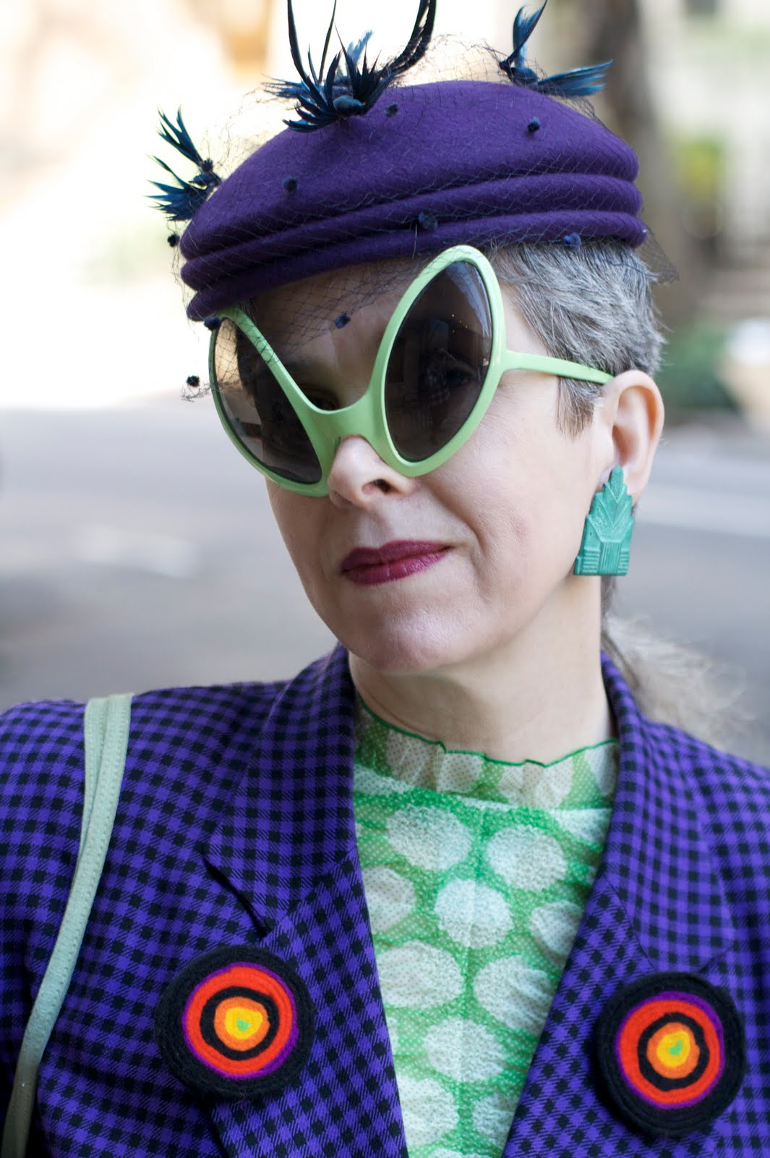
IDIOSYNCRATIC – SYNONYMS
CURIOSITY
DIFFERENT
ECCENTRICITY
INDIVIDUALISM
ODDITY
QUIRK
WACKY

Slide 5
IDIOSYNCRATIC - ANTONYMS
CONFORMITY
SAMENESS

Slide 6
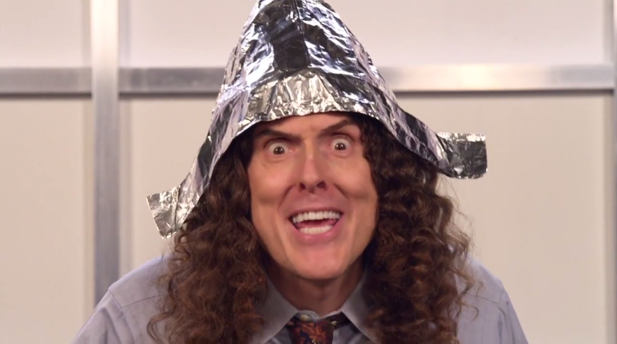
IDIOSYNCRATIC- RELATED FORMS
IDIOSYNCRASY – NOUN
IDIOSYNCRATICALLY - ADVERB

Slide 7
IDIOSYNCRATIC - SENTENCE
FILM DIRECTORS HAVE AN IDIOSYNCRATIC STYLE.

Slide 8
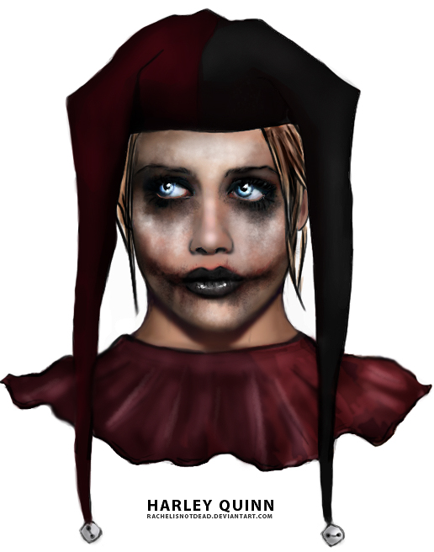
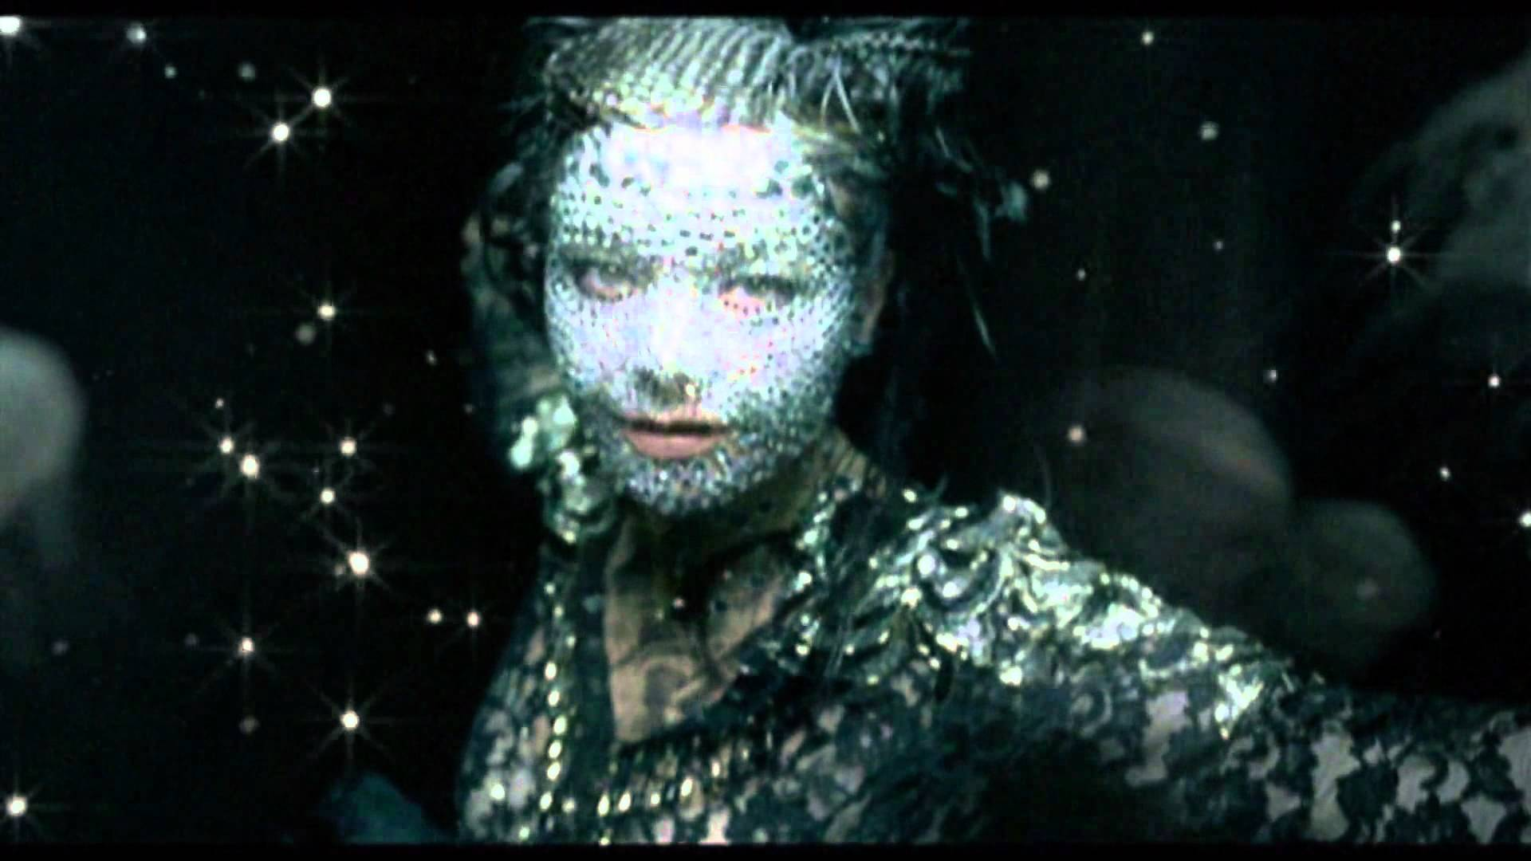
IDIOSYNCRATIC - QUOTES
THE OLDER I GET, THE MORE I EMBRACE MY OWN IDIOSYNCRASIES.
BRITTANY MURPHY - ACTRESS
I AM ONE OF THE MOST IDIOSYNCRATIC PEOPLE AROUND.
BJORK - MUSICIAN

