Slide 1
Dichotomy - noun dī-ˈkä-tə-mē
a difference between two opposite things a division into two opposite groups

Slide 2
Dichotomy- a division into or distinction between two groups that differ greatly
Her essay discusses the dichotomy between good and evil in the author's novels.

Slide 3
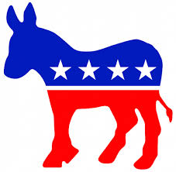
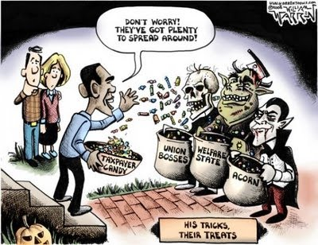
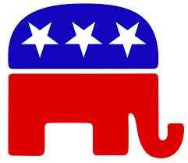
Dichotomy
They reject the old dichotomy of left vs. right politics.

Slide 4
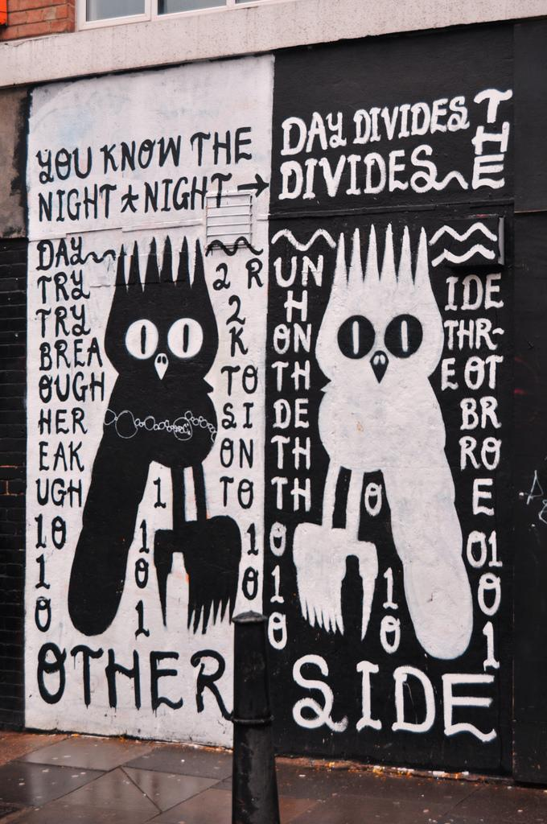
Synonyms/Antonyms
Synonyms:
Incongruity
Contradiction
Paradox
Antonyms:
Resemblance
Uniformity
Indistinguishable

Slide 5
Dichotomy
Origin: GREEK late 16th century
Plural: Dichotomies

