Slide 1
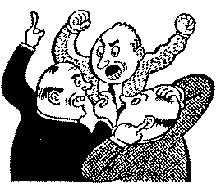
WOW
Contentious - Adjective
tending to argument or strife; quarrelsome:

Slide 2
Contentious - Synonyms
Disputatious, argumentative

Slide 3
Contentious - Antonyms
Agreeable

Slide 4
Contentious - Sentence
She often behaved in a contentious manner, and in turn, was avoided by her peers.

Slide 5
Contentious - Example
This congregation was very much occupied, being empowered to deal with all disciplinary matters concerning both the secular and regular clergy, whether in the form of consultations or of contentious suits; it had further the exclusive right to regulate the discipline of the religious orders and congregations bound by the simple vows, the statutes of which it examined, corrected and approved; finally it judged disputes and controversies between the secular and regular clergy.

