Slide 1
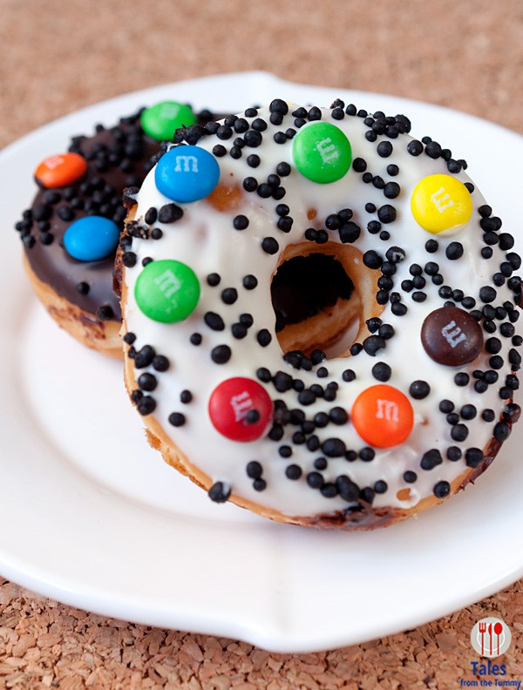
ASSUAGED
verb

Slide 2
Definition:
satisfied an appetite or desire
made an unpleasant feeling less intense
Related Forms:
assuage, assuaging

Slide 3
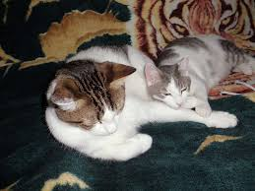
Synonyms:
gratified, appeased, fulfilled
relieved, eased, soothed
Spot assuaged his fear of thunder
by cuddling with a friend.

Slide 4
Antonyms:
dissatisfied
irritated
aggravated
upset
Tom’s fears about his Science test were assuaged when he realized he aced it.

Slide 5
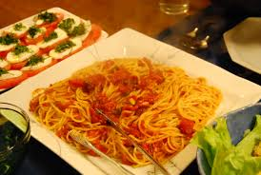
I assuaged my guilt by apologizing for what I had done.
Cameron assuaged his hunger with a big bowl of pasta.
The store assuaged the angry customers by offering them a full refund.

